Slide 1
Supply Chain Management for Sony Corporation
Student Name
Course
Institutional Affiliations
Notes:
This presentation will discuss supply chain management for Sony corporation.

Slide 2
Sony Corporation Supply Chain Management Content
Sony Company background
Evaluating Sony supply chain Management
Supply chain performance drivers
Risk Minimization within supply chain
Sony forecasting practices
Operations planning and sales
Inventory management practices in Sony
Decision in sourcing
Sony Supply Chain Sustainability
Supply chain sustainability with learning outcomes and recommendations
Notes:
Sony Company background
Evaluating Sony supply chain Management
Supply chain performance drivers
Risk Minimization within supply chain
Sony forecasting practices
Operations planning and sales
Inventory management practices in Sony
Decision in sourcing
Sony Supply Chain Sustainability
Supply chain sustainability with learning outcomes and recommendations

Slide 3
Sony Company Background
Sony was started in 1946 in Tokyo, Japan (Alhashash et al., 2019)
Expanded and opened several branches in 1958
Specialized in making products such as vides, communication and information technology
Has a hierarchical organization structure
Notes:
Sony was started in the year 1946 in Tokyo, Japan. It was named Tokyo telecommunications engineering corporation (Alhashash et al., 2019). Sony went global in the mid-50s and came up with its original name Sony in 1958, it is at this point that various branches were opened worldwide. Sony is a company that is specialized in the production of electronics including televisions, DVDs players, computers, cameras, gaming equipment and electronic appliances. It can also be regarded as a multimedia company because it is focused in the production of equipment that is vital in the creation of media. Sony’s idea of coming up with new ideas has enabled the company to make profits for over 60 years now. Sony uses a hierarchal organization structure, this allowed workers to work in groups so that the junior workers report to the senior workers. The source of finance of Sony is from the sale of electronics, music and gaming equipment.

Slide 4
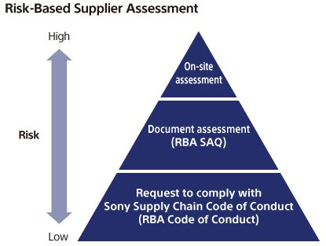
Evaluating Sony Supply Chain Management
Sourcing of raw materials
Integrating sales and operational individuals to enhance teamwork (Negahban & Dehghanimohammadabadi, 2018)
Infrastructure process involved
Increased supply to ensure market demand is satisfied
Supply chain management entails flow of goods since they were received as raw
Notes:
Supply chain management entails flow of goods since they were received as raw materials until they are changed into finished goods. Therefore, the company has managed to integrate sales and operational individuals in strategic decisions and thus they have been able to focus on performance (Negahban & Dehghanimohammadabadi, 2018). Sony uses tools that are accepted by the responsible business alliance to check progress. Due to the increase of manufactures sharing the same subcontractors, there are tensions that with the introduction of specific standards there is an increase in burden to companies in the supply chain. The company has also managed to expand its market to retailing and through this they have been able to reach market demand.

Slide 5
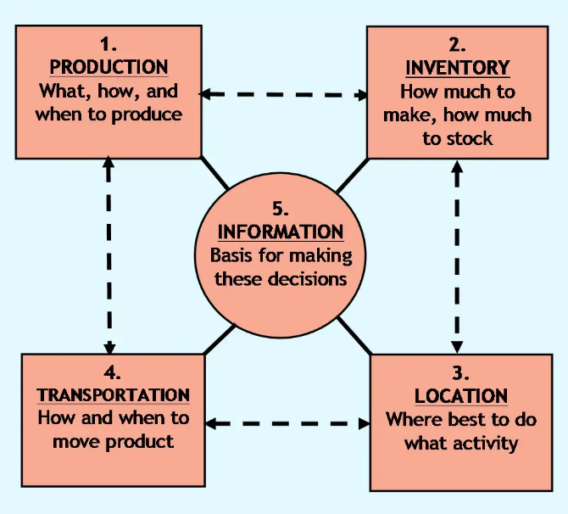
Supply Chain Performance Drivers
Production unit
Stock of goods
Mode of transport
Customer demands (Bode & Wagner, 2015)
Notes:
Production unit refers to where the product is being stored, processed, manufactured or assembled. Sony uses the responsible business alliance to evaluate submission to several areas including labor, health, ethics, environment and management. Sony should ensure customers have a wide variety of goods at their disposal, this can also be gained by availing goods close to the customer. Furthermore, through working towards innovation as a driver in the development of quality products, Sony can provide customers with products that they want (Bode & Wagner, 2015). Sony company should show responsiveness by selecting a means of transport that is fast and reliable. Sony company should collect and share relevant information to its customers in time.

Slide 6
Risk Minimization Within Supply Chain
Improve communication with stakeholders
Increase supplier transparency
Acquire redundant suppliers (Zaharudin et al., 2015)
Ensure information system backup
Notes:
Several risks are encountered in the supply chain when handling big corporations such as Sony. Therefore, to counter the problem company’s must find mitigation measures to counter the impact of risks and thus continuing with their operation. Before doing that companies will have to recognize the risks before developing the means of countering them. The success of the Sony supply chain is attributed to the mitigation of risks such as improving communication among their stakeholders because it will allow them to know what is happening and provide decisions on time. Also, through increased transparency with their suppliers, the company will know when there will be delays in materials and find alternative solutions to deliver products on time hence the reason for having redundant suppliers (Zaharudin et al., 2015). Information is very critical, therefore, through having a good backup that will ensure the company continues to run irrespective of one system failing is very important.

Slide 7
Sony Forecasting Practices
Innovation and maker of high-quality products
Uses trend development in product making
Sensitive in competitors’ actions and reactions
Well-designed customer satisfaction strategies
Notes:
The market demand for Sony products has increased significantly due to the practices employed by the corporation. Although managing the market demand has always been a challenge in many organizations, however, in Sony corporation, they have managed their plans and focus through innovation and developing products that are of high quality. This has enabled them to sell their products at a higher price than their competitors. Also, through the use of statistical information in the marketing demand enables them to build products based on the trend in their sales. Being keen with competitors’ actions and reactions so that they can boost the quality of their products and strategies. Lastly is through a well-designed customer satisfaction strategy such as developing offices for customer care and allowing fast repair and warrant products.

Slide 8
Operations Planning and Sales
Tracking accepted key performance reminders
Performing regular meetings to put together operations together with strategy
Having a common plan among the finance, sales as well as supply chain departments (Chang, & Rosenzweig, 2016)
Notes:
The market environment is currently filled with competition, therefore, for Sony to earn a competitive advantage over their competitors, they needed to ensure they integrate the customer-focused marketing plans with the supply chain group. Furthermore, the process ensures that team members are brought together thus creating unity among different units in the organization such as sales, manufacturing and sourcing units (Chang & Rosenzweig, 2016). Also, all the units will work towards accomplishing a common goal. the team members will be performing meetings frequently to ensure all the strategies are aligned together with the operations. Moreover, since the operations and strategies will be aligned, they will be able to track their key performance and ensure the objectives are attained at the required time.

Slide 9
Inventory Management Practices in Sony
Centralized inventory management system (Sony, 2019)
Regularly check and update data in their operations
Real-time data optimization
Safety stock
Notes:
Although the practice of inventory management is critical in Sony corporation, they have utilized strict measures that will ensure the desired revenue is achieved. Therefore, operations managers make tactical decisions by bearing in mind suppliers’ capability and client fulfilment aims. Sony has focused on developing a centralized inventory management system that will allow the management individuals to recognize and update inventory and operational necessities (Sony, 2019). Furthermore, the managers will also need to frequently check and update data in their operations which is one of the corporation’s operational standards. Through these methods, Sony can get real-time data optimization that will improve the inventory and related output variables. Safety stock practice is performed to guarantee there is no opening of time in providing client orders.

Slide 10
Decision in Sourcing
Control for quality
Access to better skills and talent
Reducing cost
Availability of cutting-edge technology and infrastructure
Improved efficiency
Notes:
The decision on the sourcing of materials to make Sony products is done based on several factors. For instance, Sony has a wide market on where they can source their products whether internally or outside the company. Therefore, to make this decision they must consider issues such as quality control of their products. Sony has developed through providing high-quality products thus the process begins with the raw materials used. Furthermore, when they need to access better skills and talent, they should source their products outside at the same time reducing the cost of production and maintain quality. Sourcing decisions are also aimed at getting cutting-edge technology in the products thus improving efficiency.

Slide 11
Sony Supply Chain Sustainability
Regulatory pressure and compliance
Stakeholder interest
The amalgamation of the supply chain with other units
Enhanced communication
Notes:
Supply chain sustainability in Sony corporation is through customer-centric approaches because they are the reason behind the success of the company. Despite the company working hard towards providing innovative and quality products, Sony has to set regulatory pressure and compliance for their suppliers to ensure they provide satisfying materials. Thus, improving customer interest and making sure they are satisfied with the products developed. Furthermore, supply chain integration with other units in the company enables them to monitor the plans and operations together thus improving the success in market demand. Also, communication has played a bigger part in the success of supply chain sustainability because Sony has managed to keep in touch with their customer anytime.

Slide 12
Supply Chain Sustainability With Learning Outcomes and Recommendations
Adjustment of the supply chain process has resulted in the success of the company
Capacity to adapt to the changing needs of customers and the business environment
Integration of different units in the company
The company should keep on reviewing their information technology system due to rapid changes in the field
Focus on unique and environmentally friendly materials in the development of their products
Notes:
As reviewed earlier, it can be noted that the outcome of the Sony Corporation is a success due to the adjustments made in their supply chain process. Although it was hard for the company to make the changes and it took long, they managed to integrate different corporation units such as finance and sales and ensure they develop and work on common plans. This enabled them to measure the performance of the plan. Furthermore, Sony could adapt to the varying business environment ad thus facilitated them with ability to outdo their competitors. I would recommend that Sony to keep on reviewing their information technology systems so that they can be always ahead based on the rapid changes in the field as well as focus on unique and environmentally friendly materials in the development of their products.

Slide 13
References
Alhashash, F., Alshammari, T., & Al-Mnaies, A. (2019). Sony Corporation. Journal of the community development in Asia, 2(2).
Bode, C., & Wagner, S. M. (2015). Structural drivers of upstream supply chain complexity and the frequency of supply chain disruptions. Journal of Operations Management, 36, 215-228.
Chang, S. J., & Rosenzweig, P. M. (2016). Subsidiaries: Sony in. Multinational Corporate Evolution and Subsidiary Development, 299.
Negahban, A., & Dehghanimohammadabadi, M. (2018). Optimizing the supply chain configuration and production-sales policies for new products over multiple planning horizons. International Journal of Production Economics, 196, 150-162.
Sony, M. (2019). Green supply chain management practices and digital technology: A qualitative study. In Technology optimization and change management for successful digital supply chains (pp. 233-254). IGI Global.
Zaharudin, A., & Yunus, A. M. (2015). Delays in physical distribution: a case study of sony supply chain solutions Malaysia.

